Slide 1

HOW TO UPLOAD YOUR FILES TO THE INTERNET
BY GRADE 9 IT TEACHERS

Slide 2
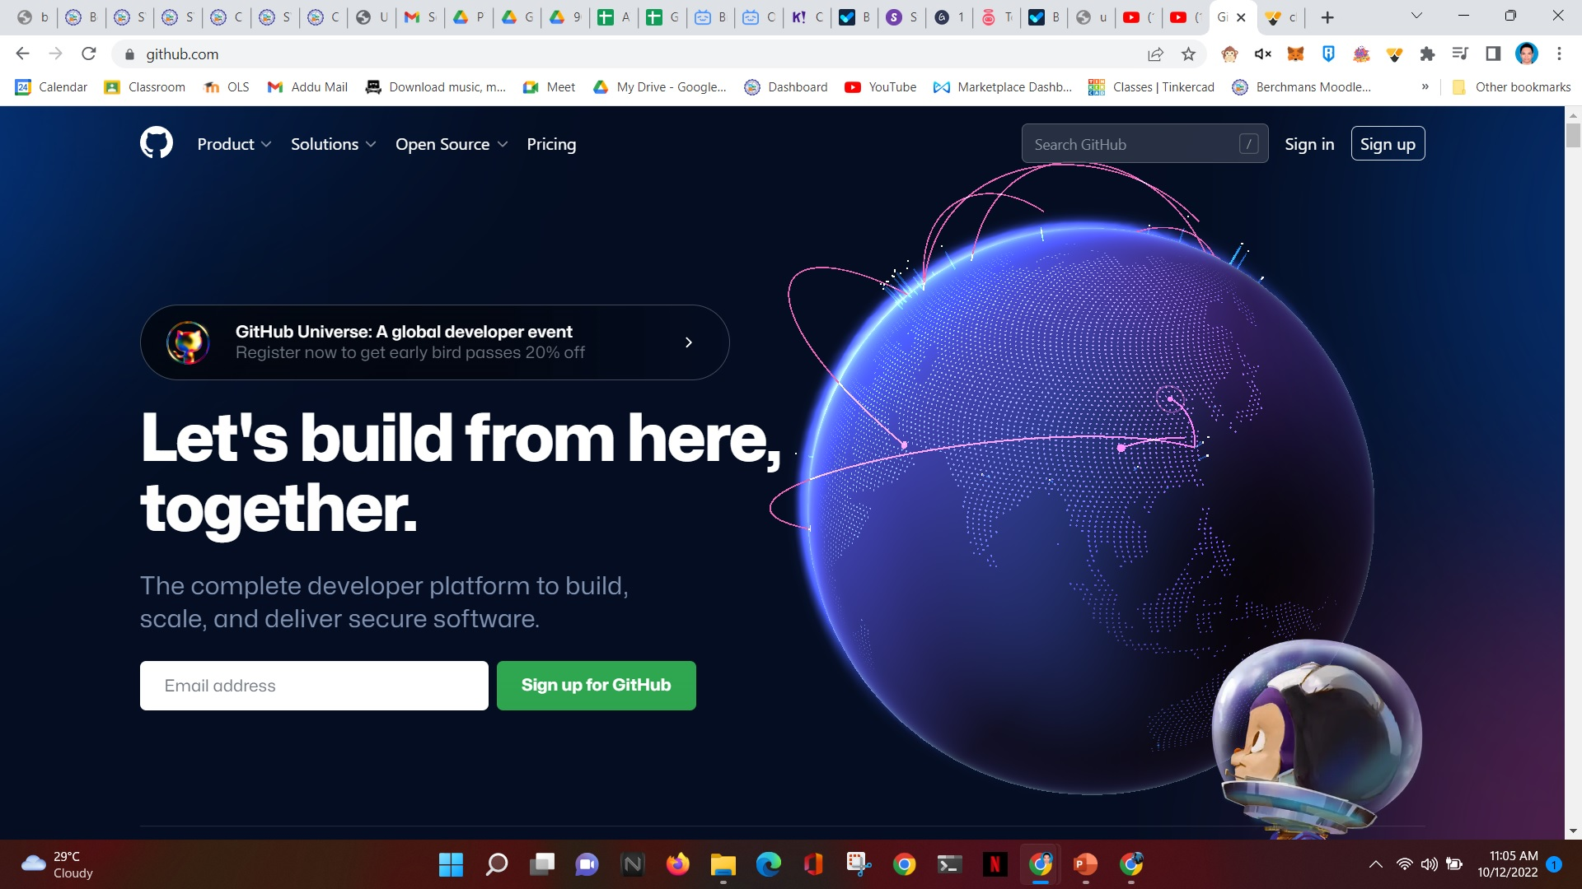
Go to github.com

Slide 3
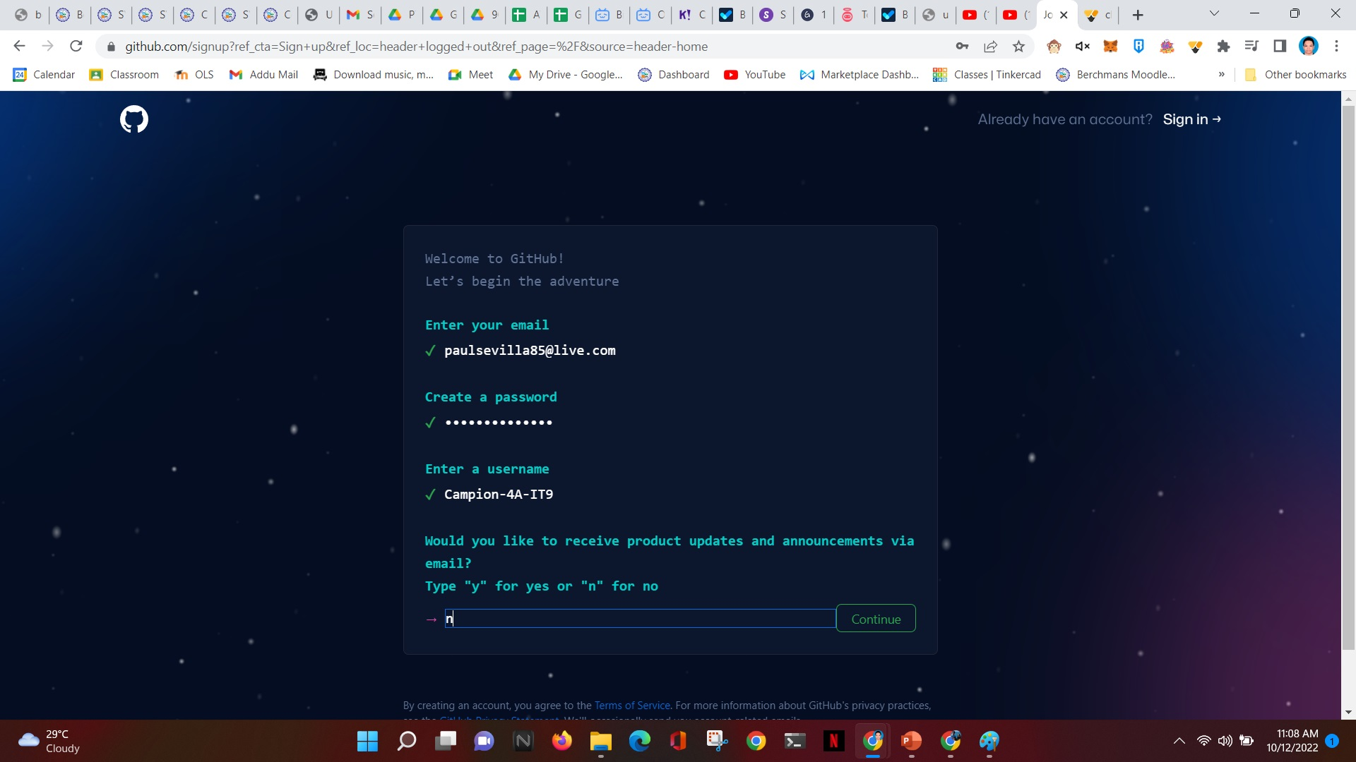
Enter your school email address
Choose a password
Username should be your Section-Group-IT9
Enter N
Click Continue

Slide 4
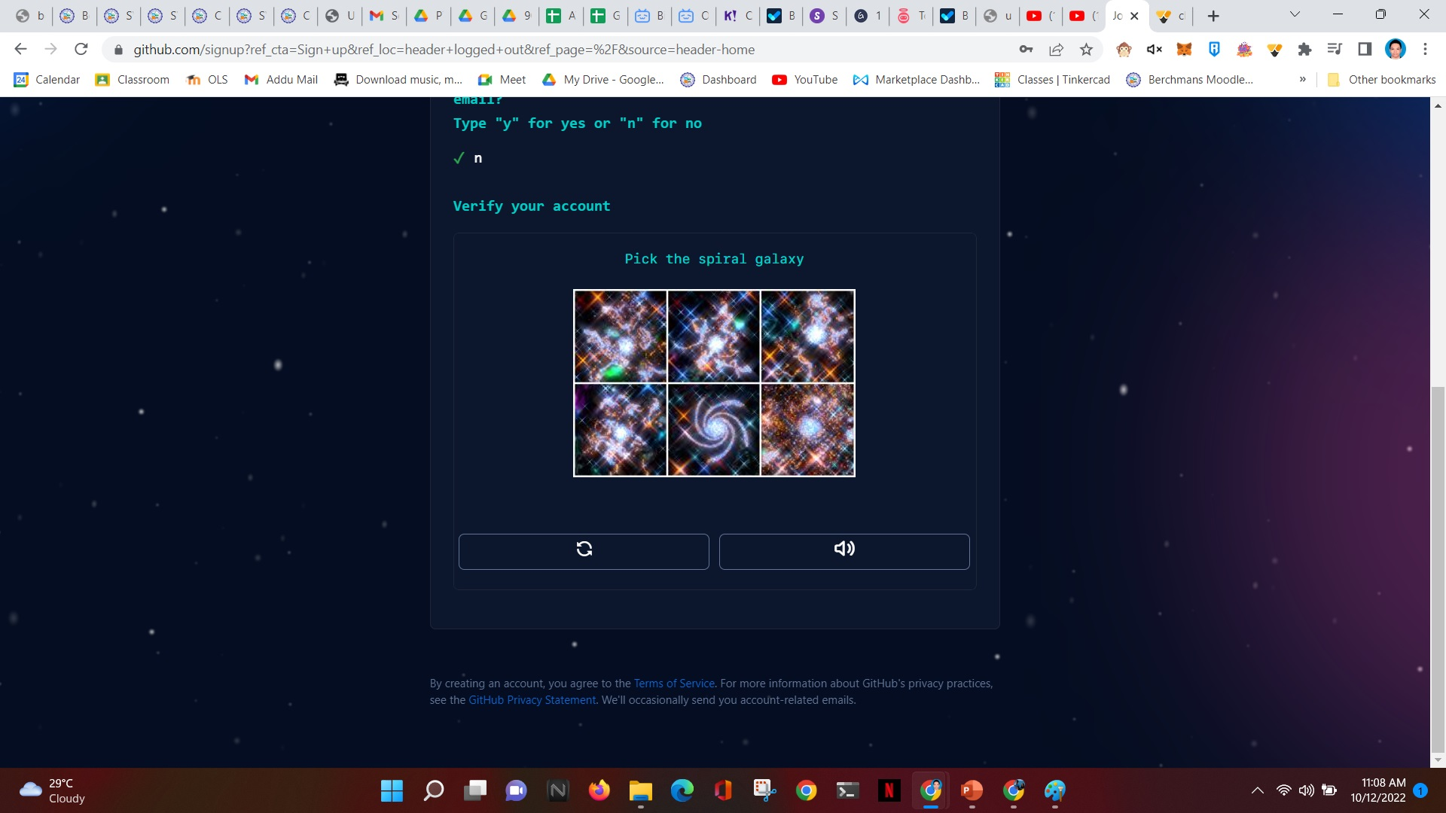
Scroll down
Solve verification puzzle

Slide 5
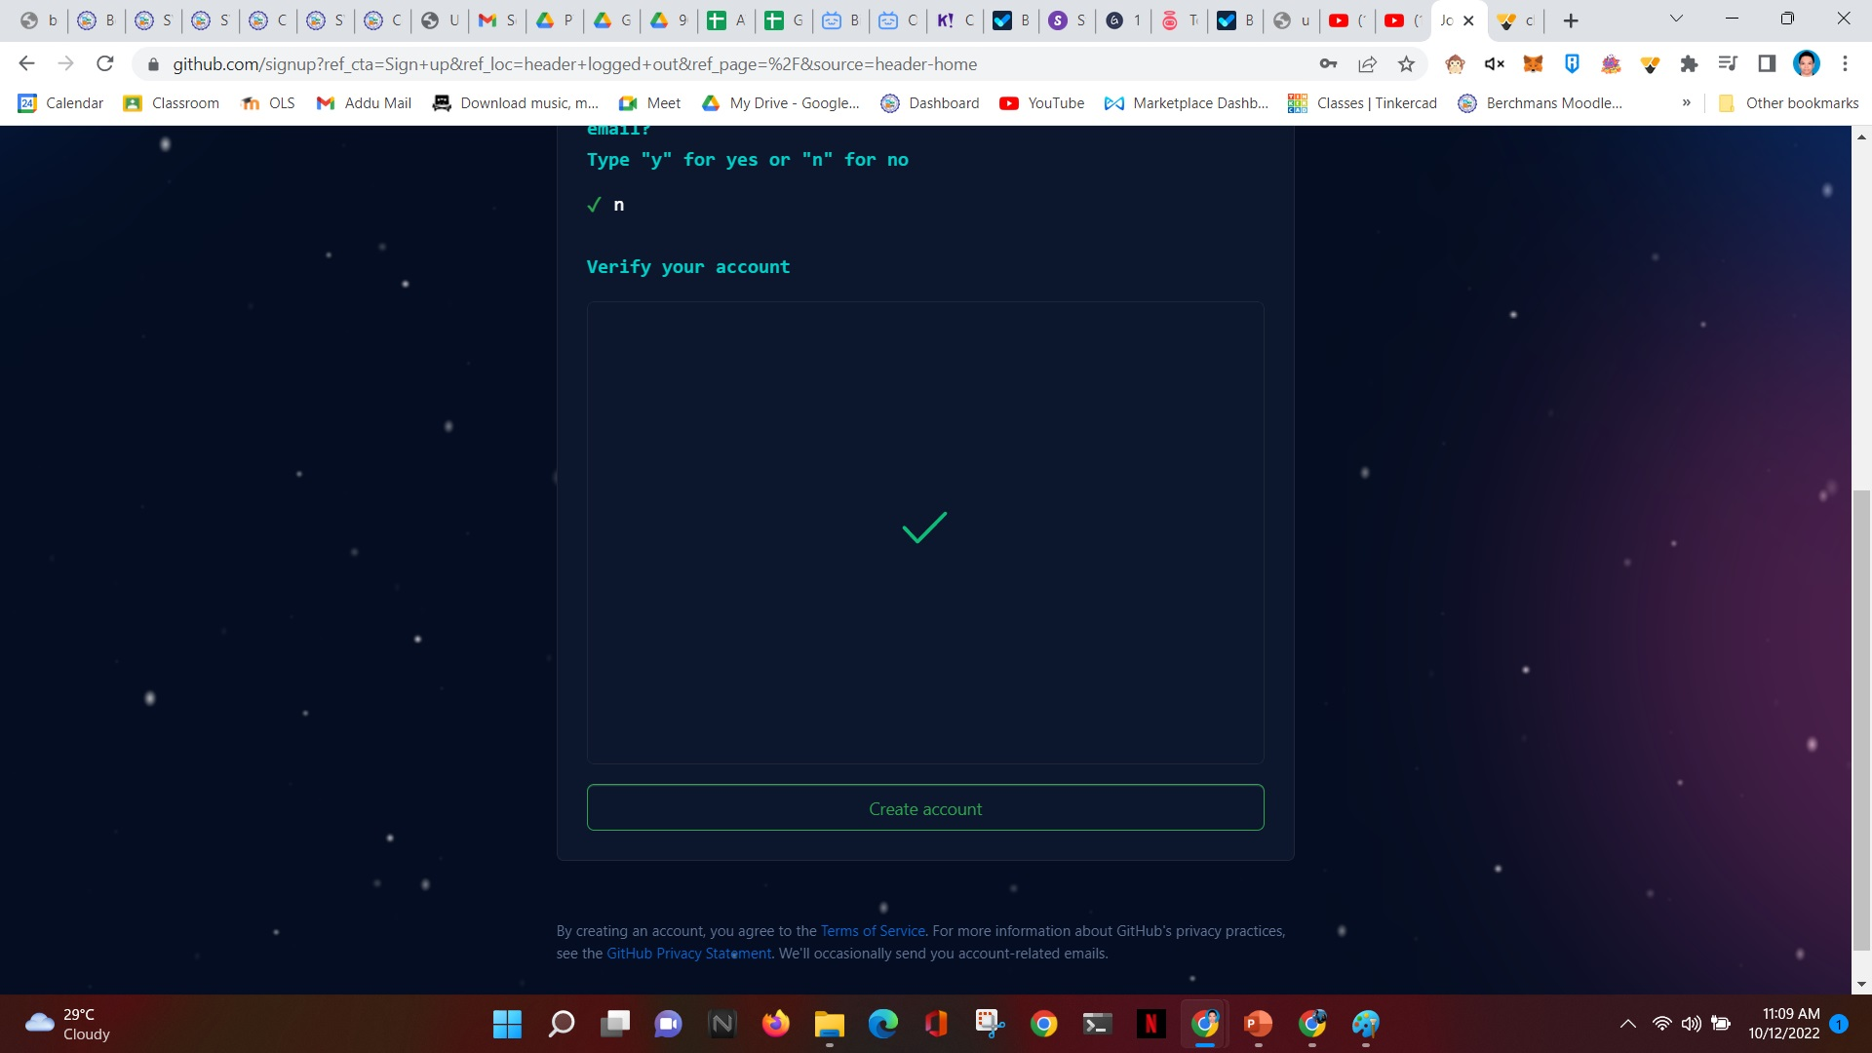
After verification, a check mark will appear
Click Create Account

Slide 6
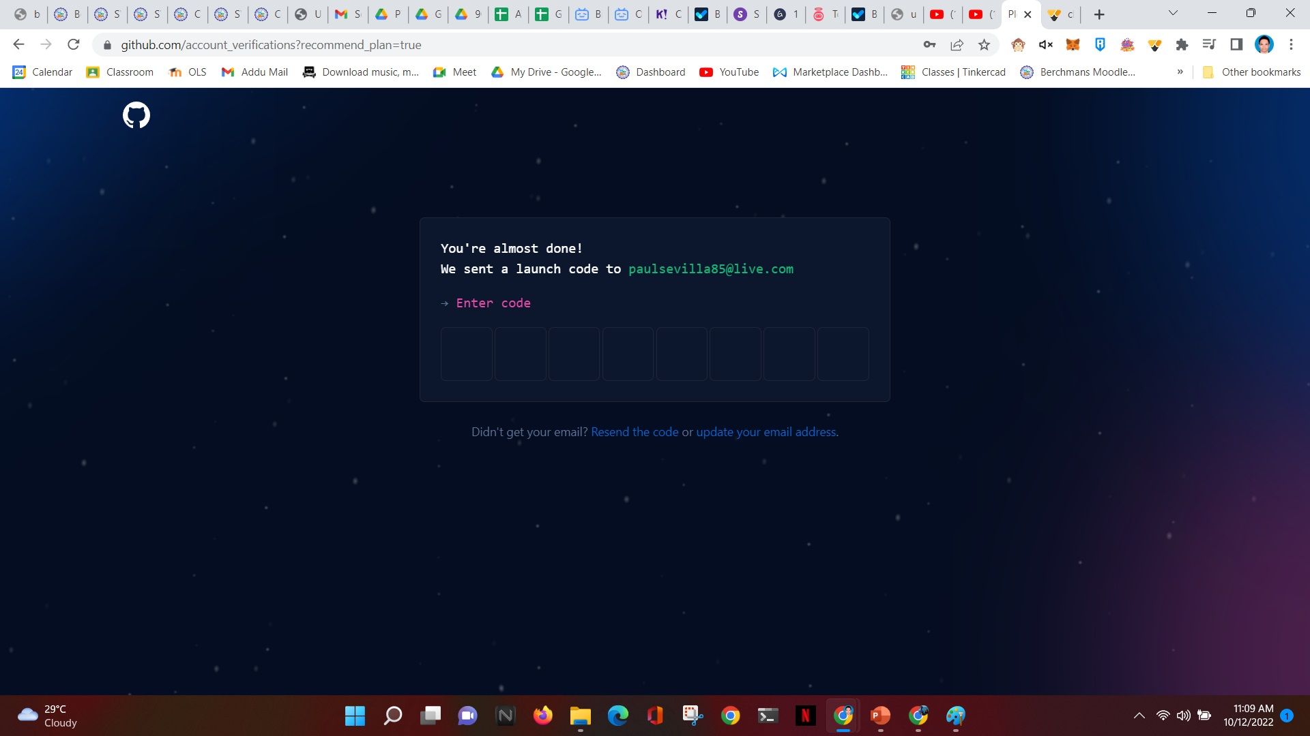
Open your email. Check inbox for email verification sent by github.com
Enter 8-digit launch code from email here.

Slide 7
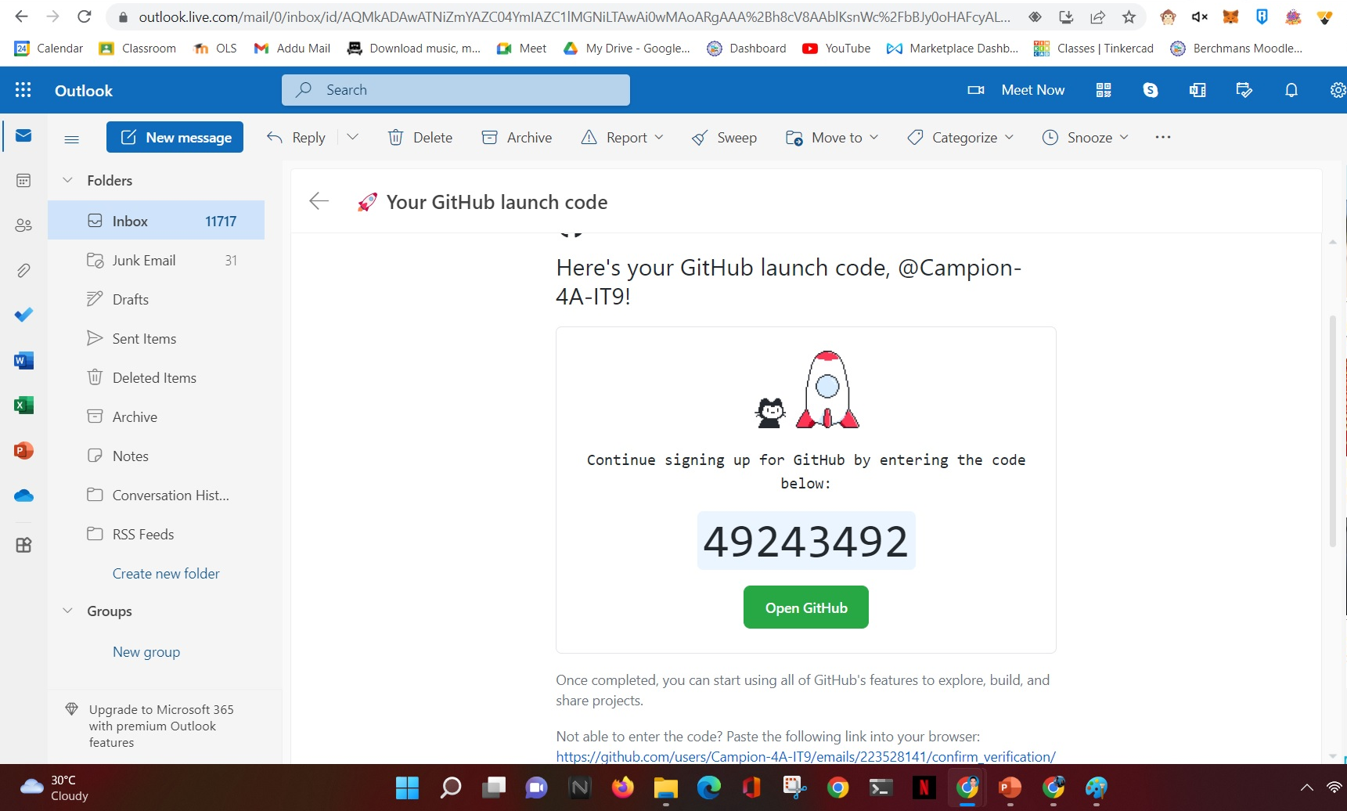
Sample Github email
8-digit launch code

Slide 8
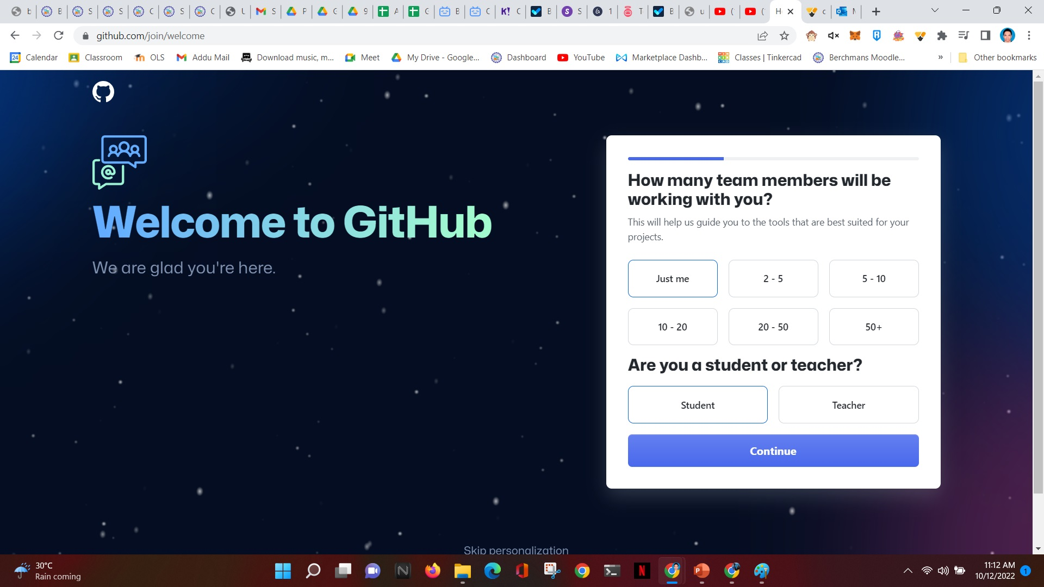
Choose “Just me”
Choose Student
Click Continue

Slide 9
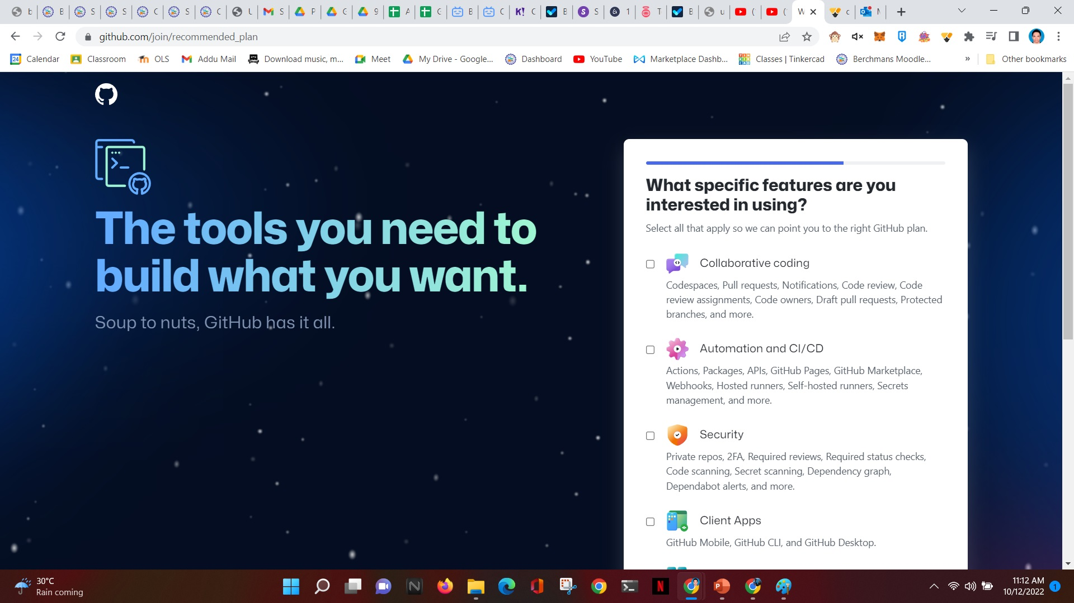
Scroll down

Slide 10
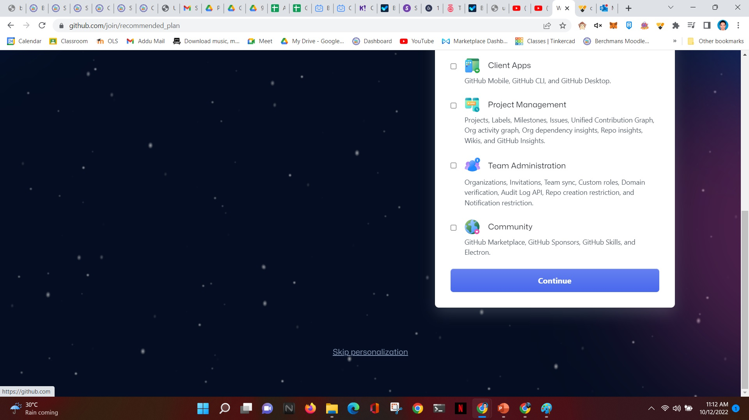
Don’t tick any boxes!
Choose Continue

Slide 11
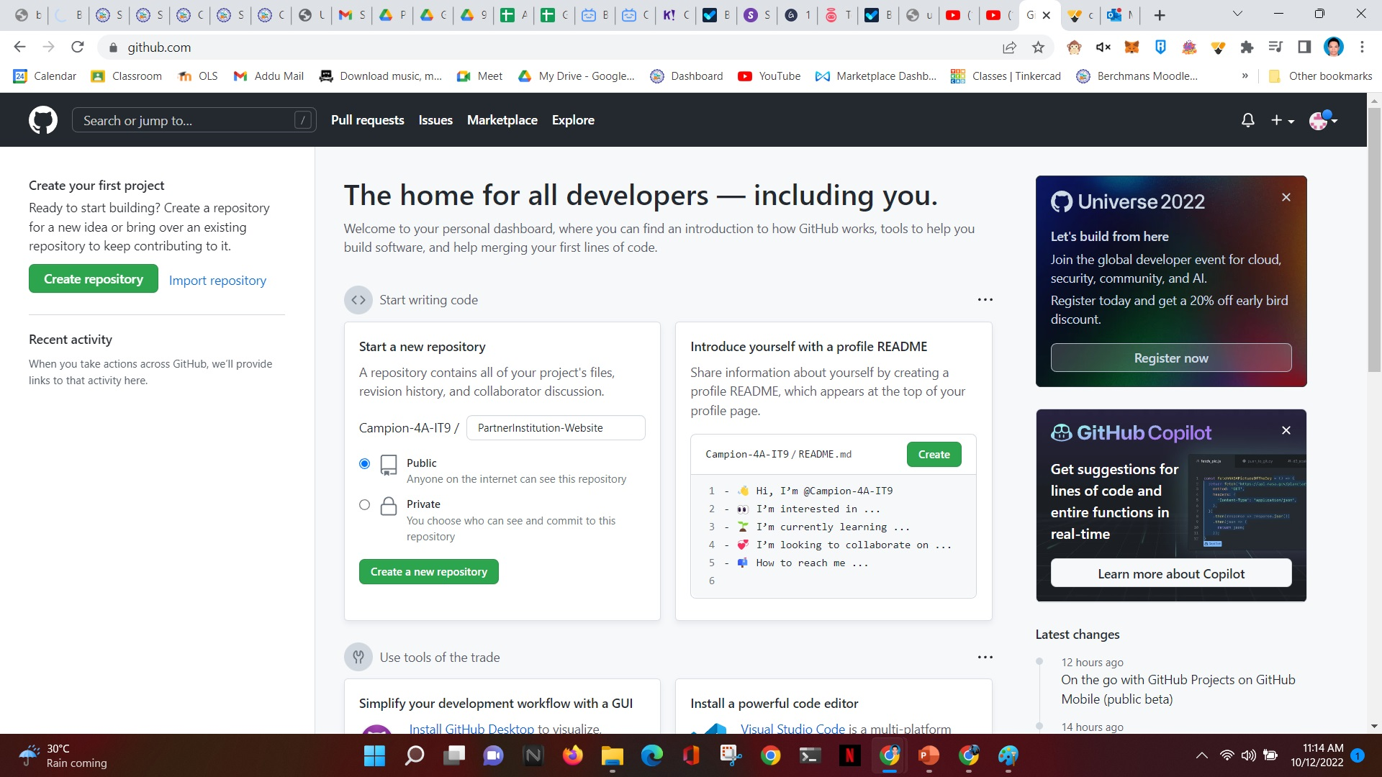
In this step, you are to create your own repository in Github. Remember to name your repository your Partner Institution Name then add –Website.
Example: Campion-4A-IT9/Talikala-website
Where Talikala is the name of your Partner Institution.
Type your Partner Institution Name then add -Website
Choose Public
Click

Slide 12
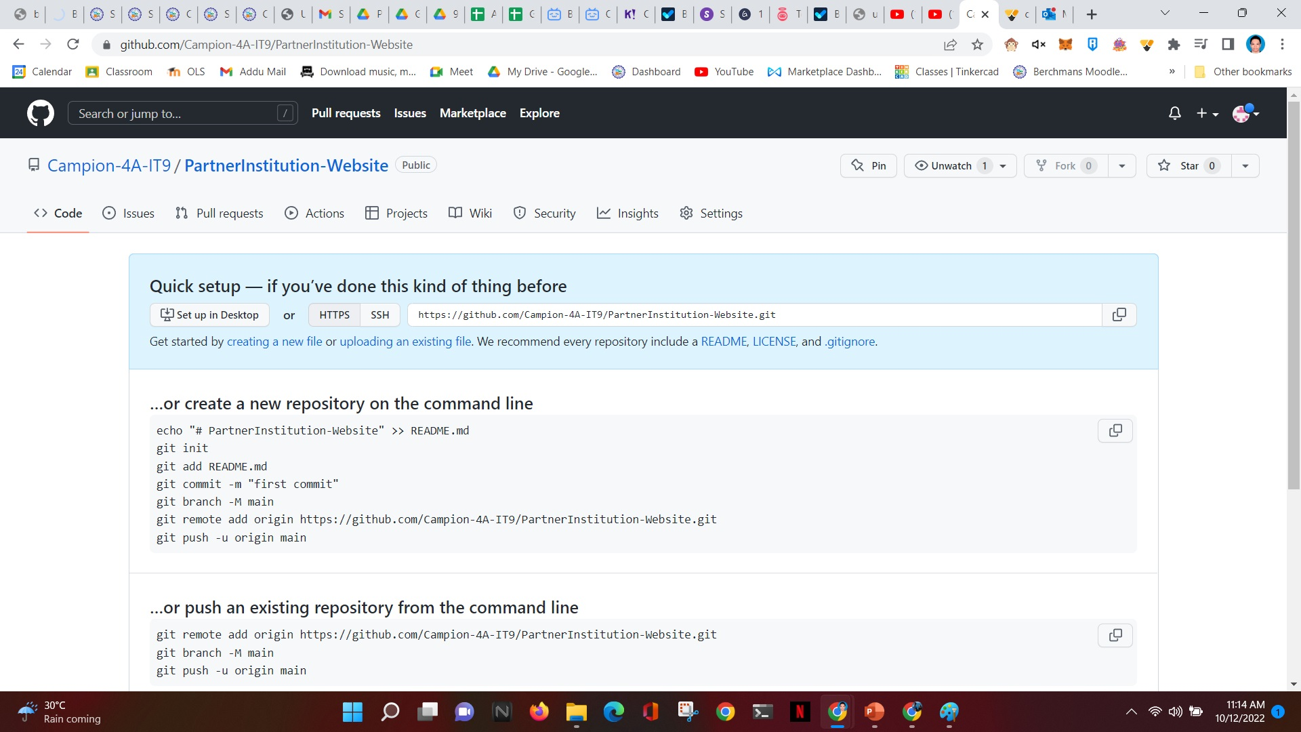
You are now in your Repository.
Click “uploading an existing file”
This step is where you upload your website files to your repository.

Slide 13
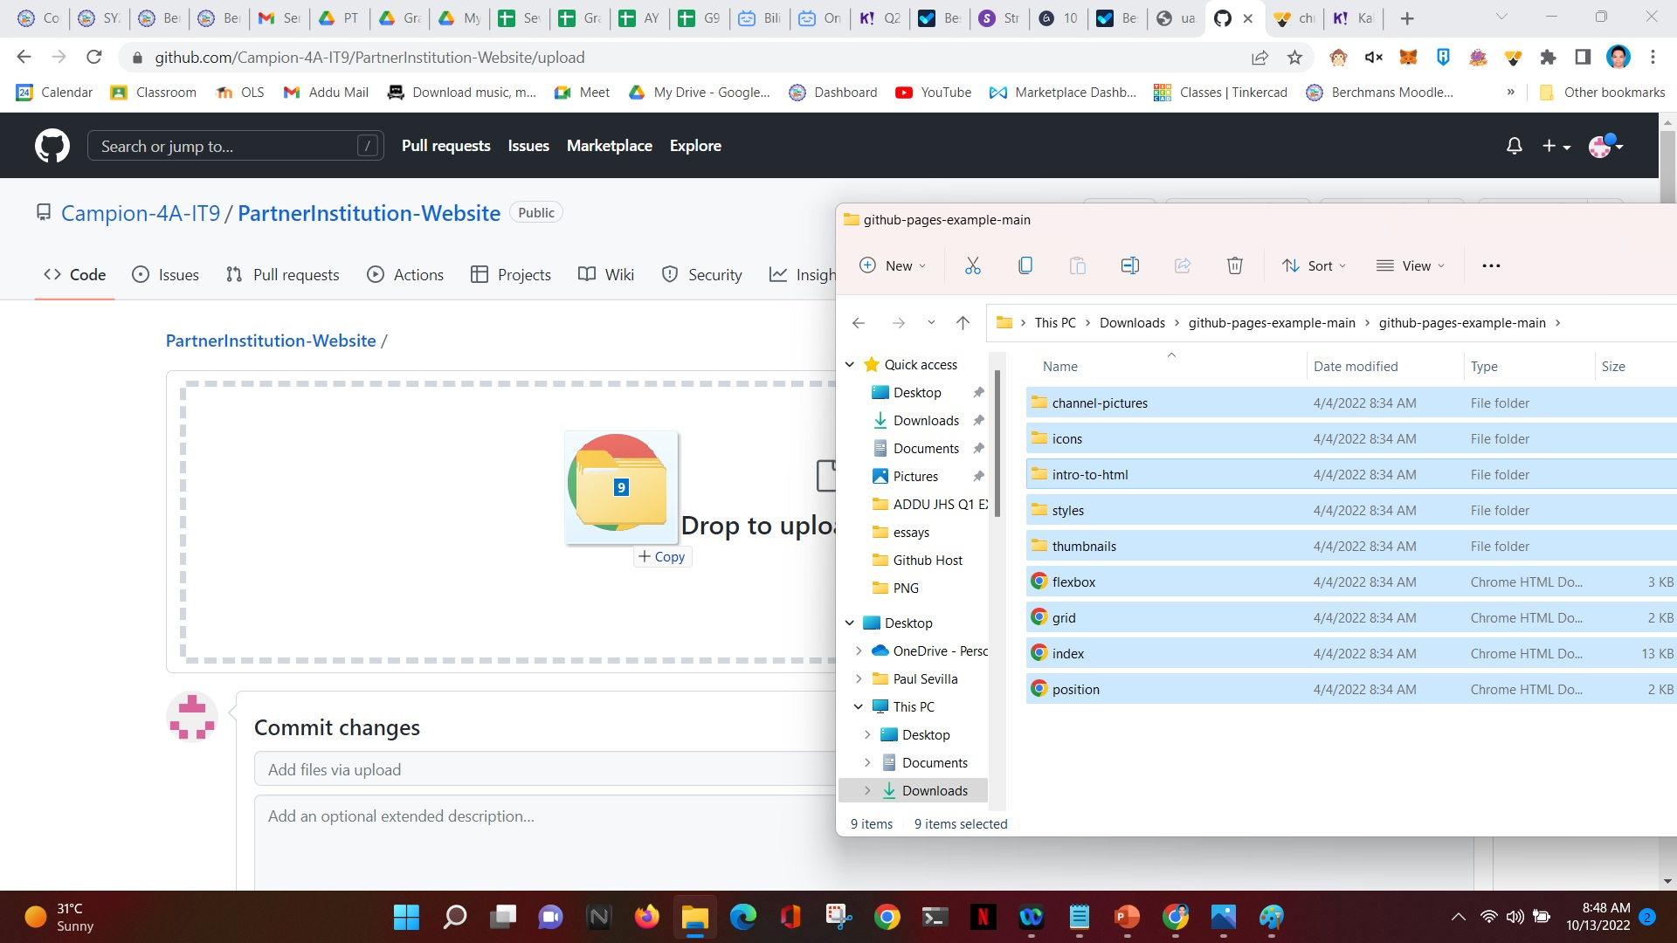
1
Open your PT website folder.
This is where your PT files are located.
3
Drag and Drop all files to this area
2
Select all files inside the PT folder.

Slide 14
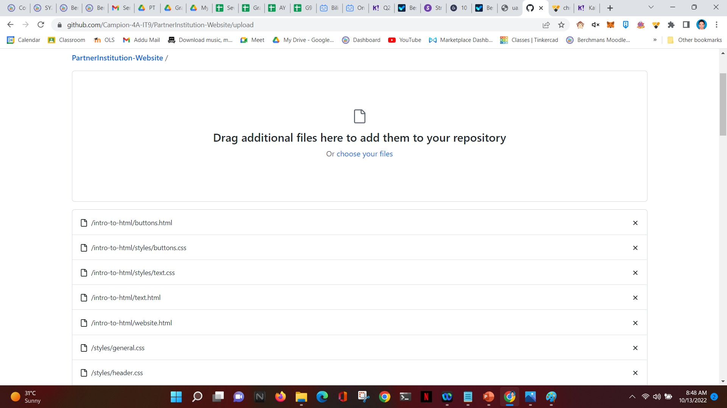
This will show up. Just wait for uploading to start.

Slide 15
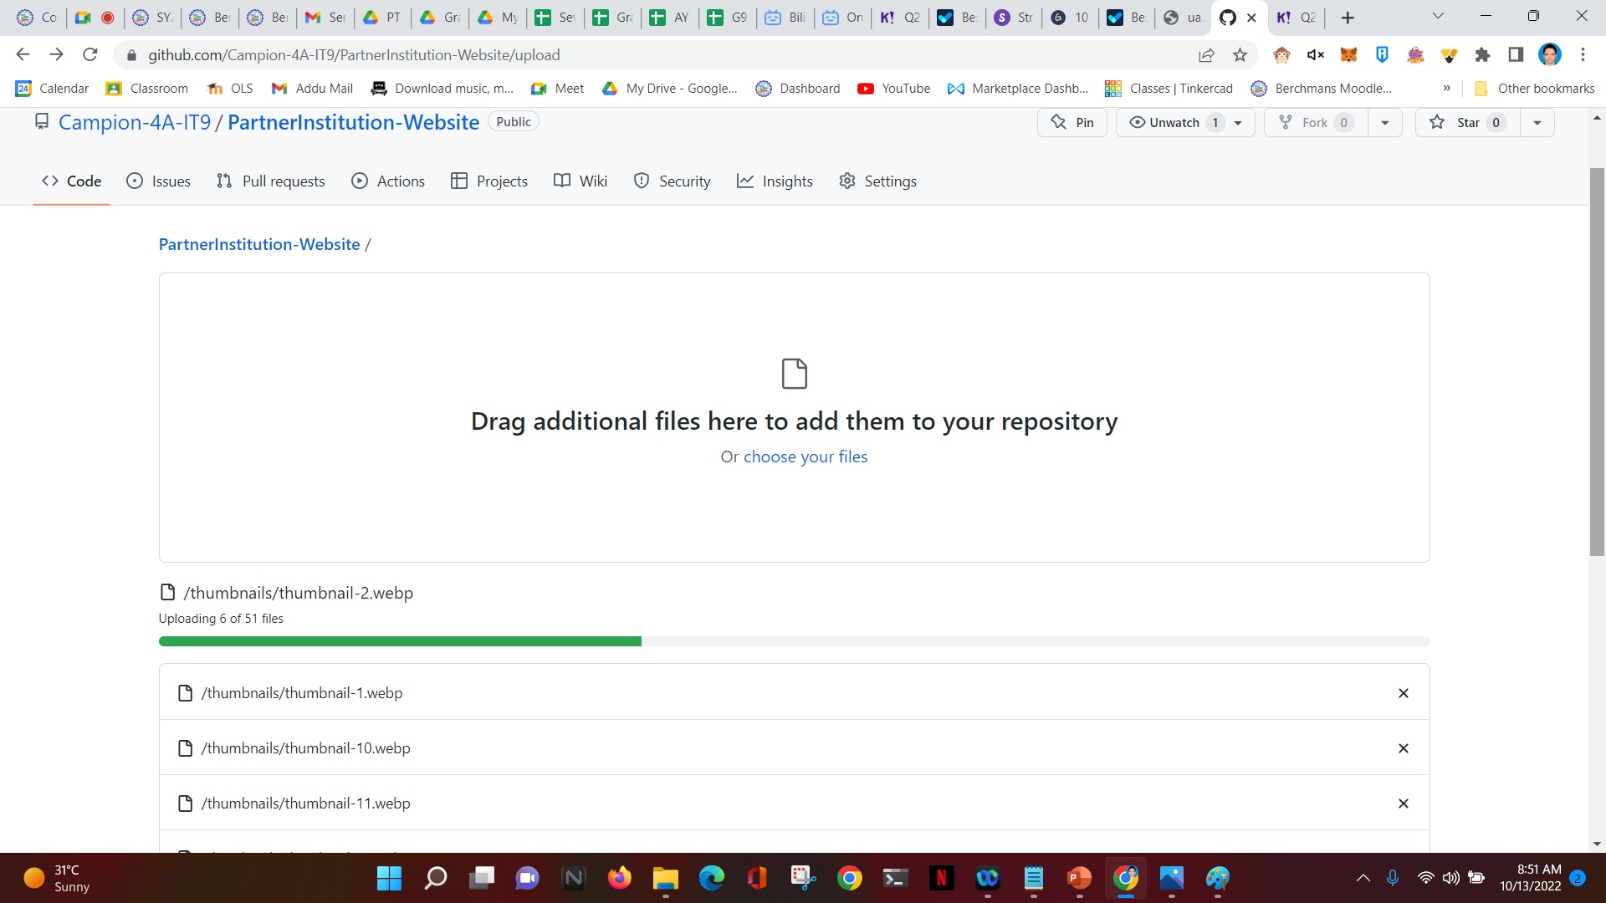
Notice your files will all be uploaded one by one here. Scroll down to see the submit button.

Slide 16
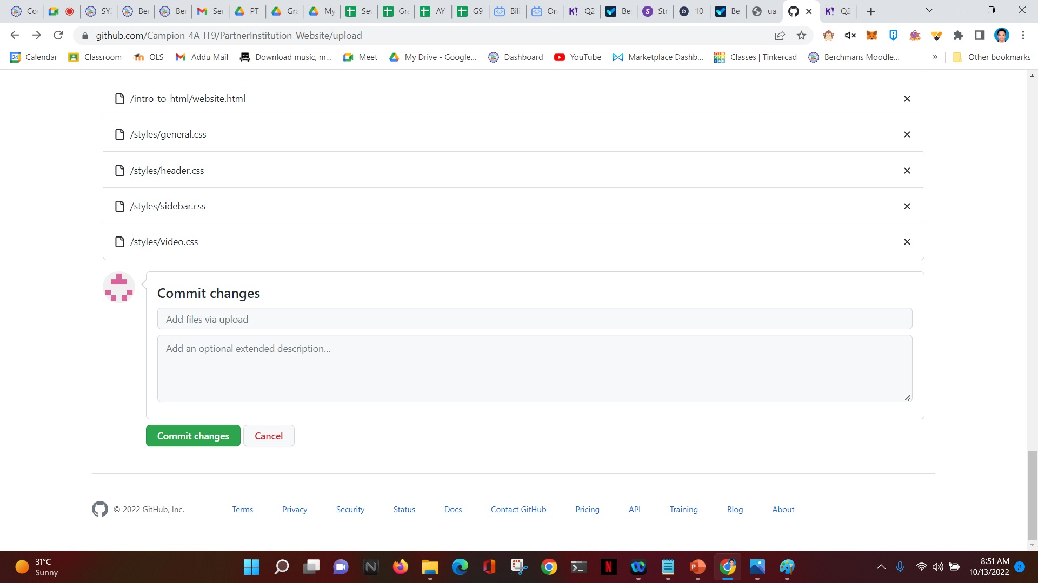
After uploading is done, click Commit Changes.

Slide 17
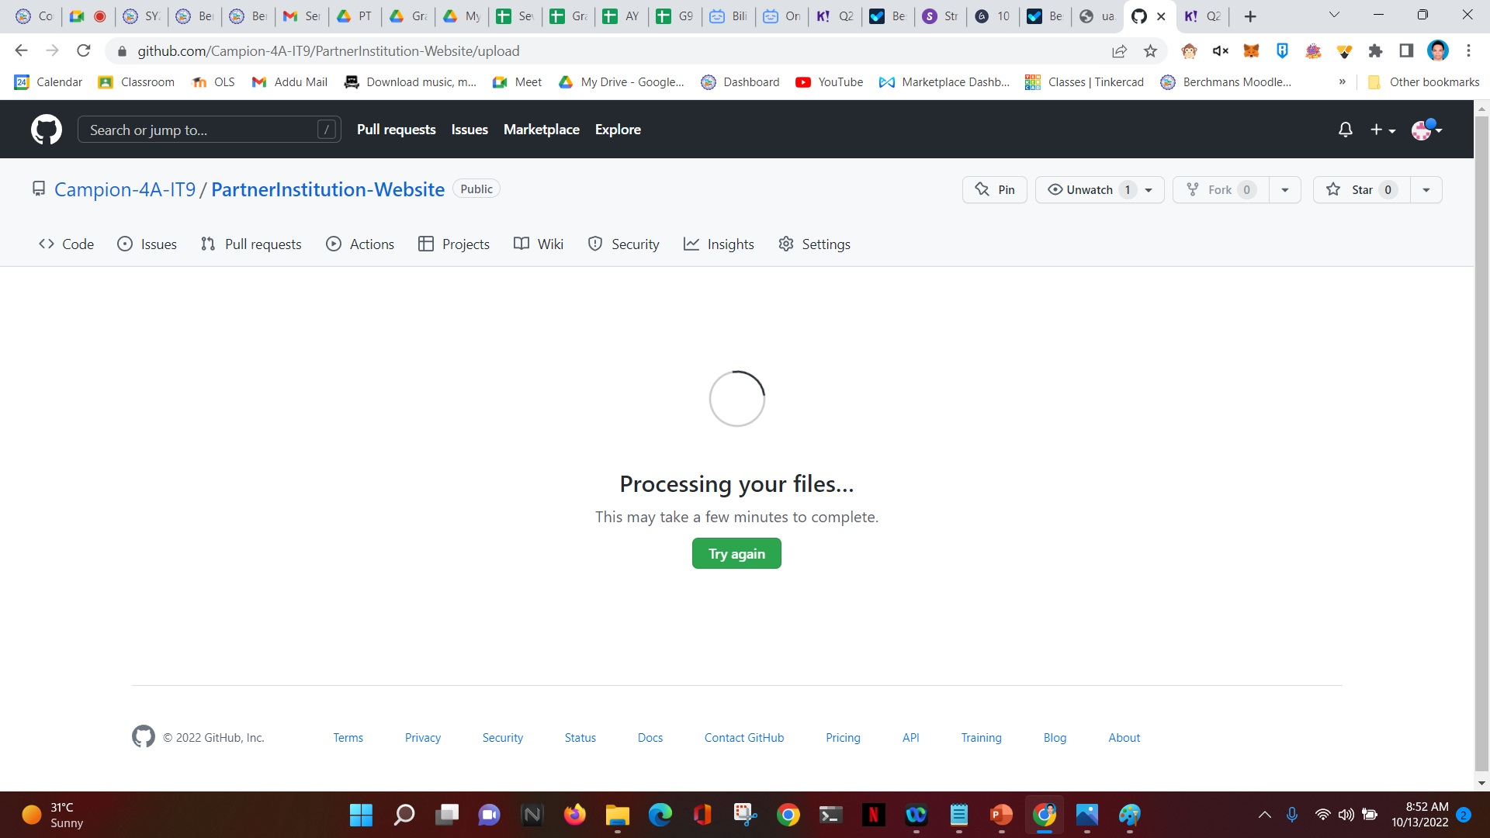
This will show up. This means that github is processing your files, uploading your files, and making necessary changes to your repository.

Slide 18
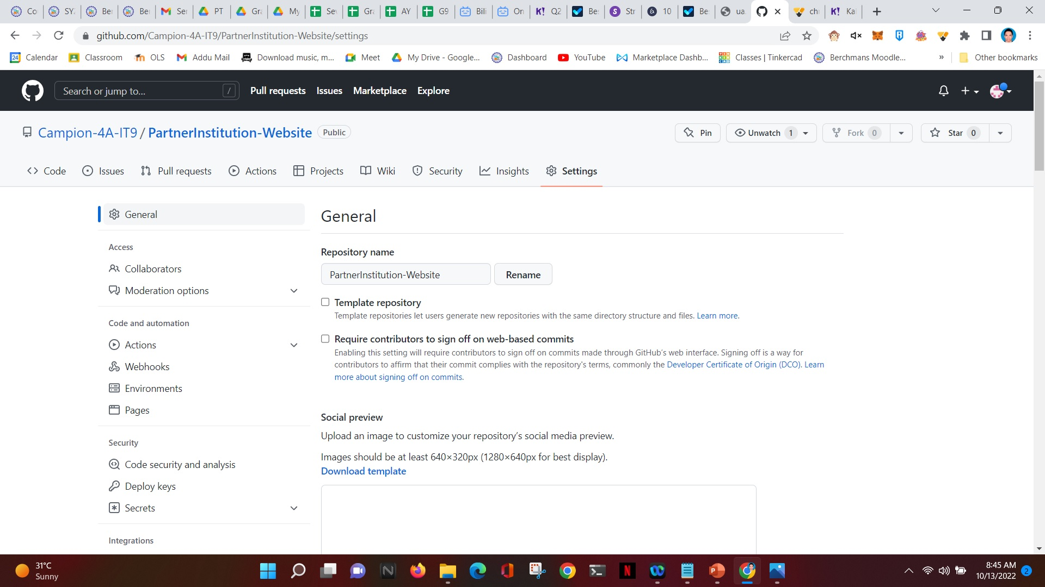
After uploading, click settings.
Click Pages

Slide 19
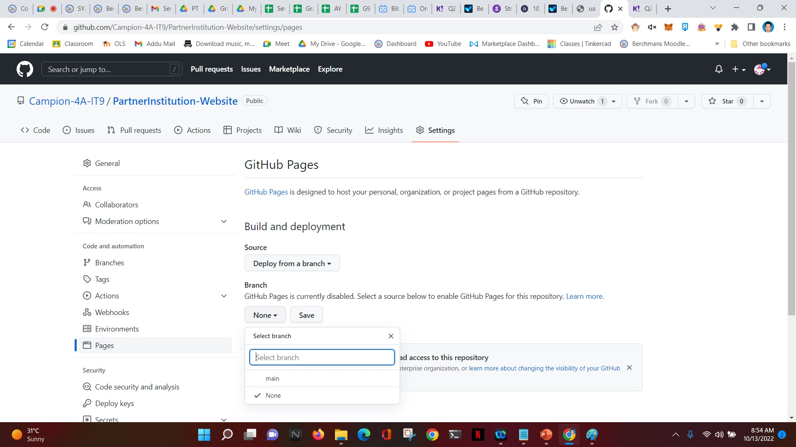
Click None
Choose “main”

Slide 20
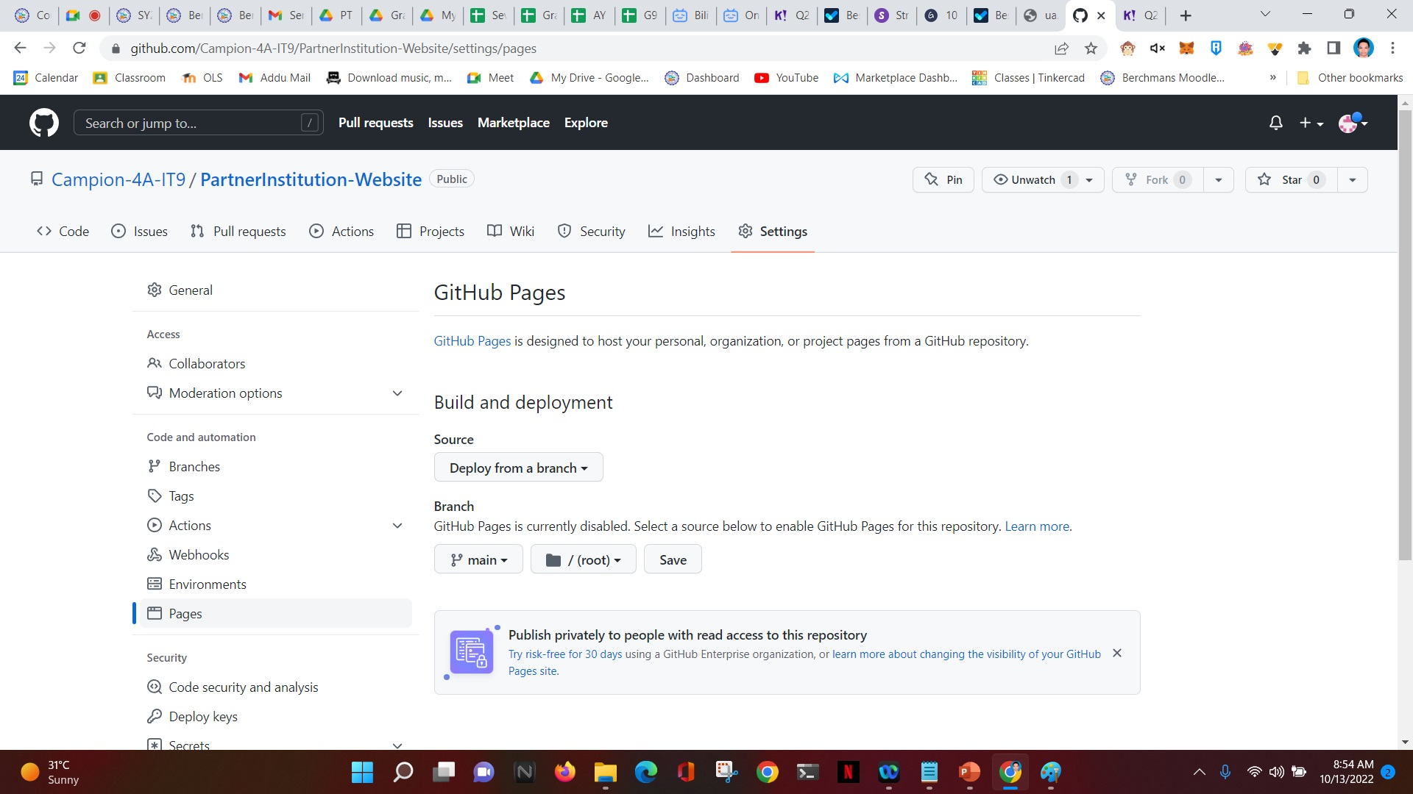
This will show up after choosing “main”
Click Save
Note that after clicking save, github may not be visibly doing anything. But rest assured that it is processing your website. It will take approximately 10-15minutes for it to make your website available online. Refresh this page after 5-10-15mins. Just be patient!

Slide 21
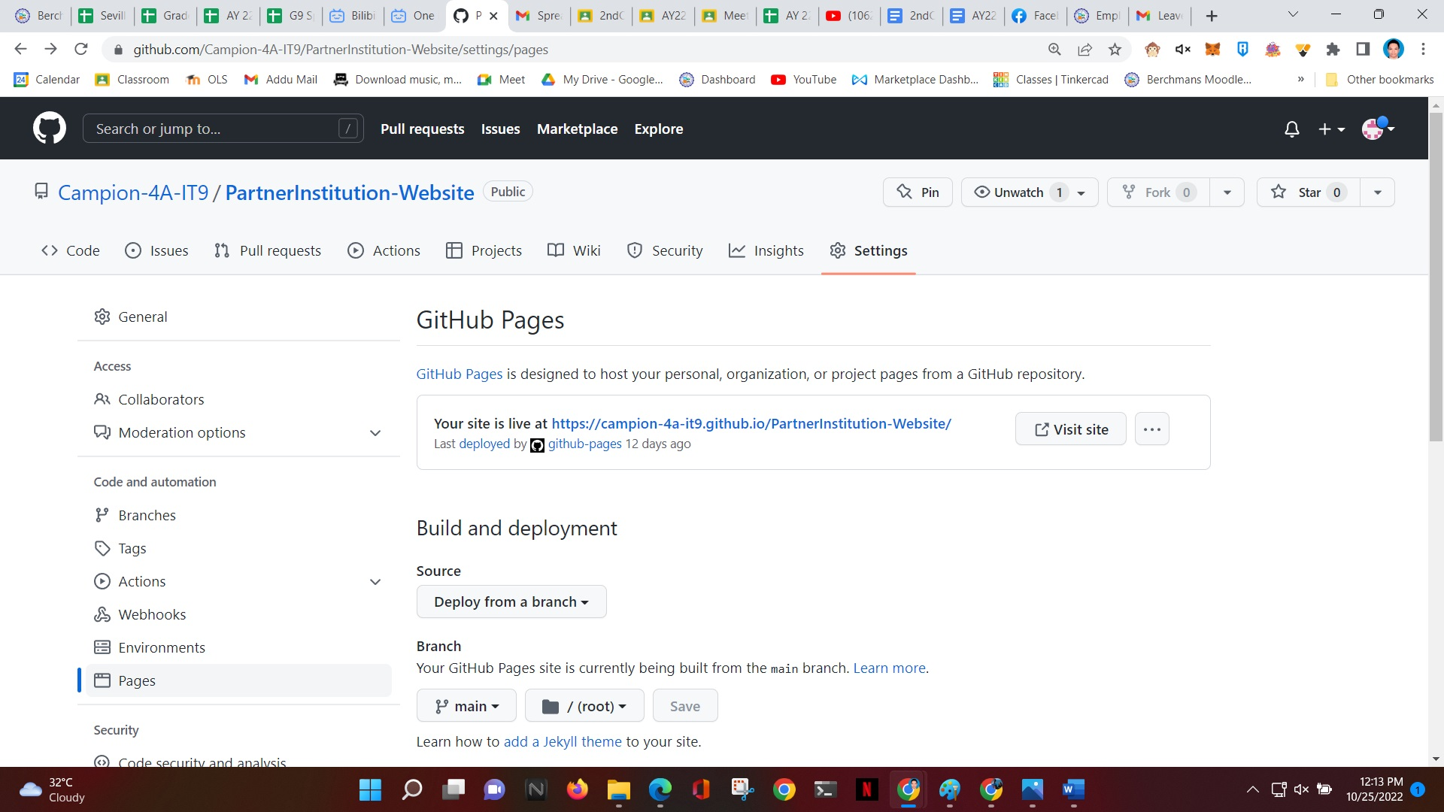
This will appear after 10-15mins. Just refresh the page after 10-15mins if it still does not appear. If you see this, it means your website is online and already accessible on the internet.
Click Visit site to access your website on the internet.

Slide 22
You’re done!
Congratulations!

